Slide 1
British Airways
Customer Reviews Analysis And INSIGHTS
March 2024

Slide 2


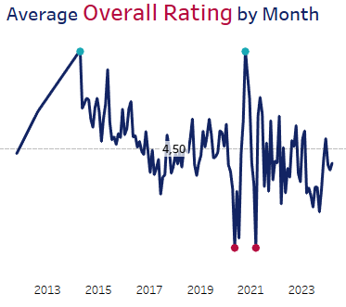
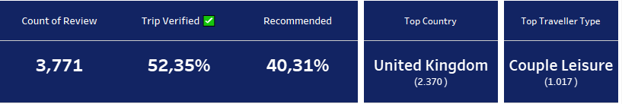

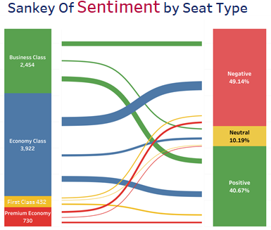
3
Overall Rating 4.72 and the mid-level or satisfactory star ratings for each service aspect indicate that further improvements or enhancements are still needed.
Furthermore, upon thorough data analysis, it's evident that there's a slight downtrend in the overall average over time, with an average rating of 4.5, underlining the importance of a comprehensive evaluation to identify its root causes.
Given the relatively low count of 3771 reviews, especially considering the timeframe spanning from 2011 to 2024, it's imperative to implement strategies to incentivize customers to share their feedback post-experience.
1
Through text processing, the generated word cloud above illustrates that the overall reviews predominantly revolve around experiences during flights.
However, if we look at the negative sentiment reviews, which comprise 49%, it indicates the need for an in-depth investigation into areas of improvement or issues requiring immediate attention, aiming to enhance customer satisfaction and overall experience
2
In the above Sankey chart, it’s evident that customers in the economy class tend to have a higher distribution of negative sentiment, whereas the business class shows a more balanced distribution between positive and negative sentiments.

